Slide 1
Intermediate presentation
Libby Blair, Tom Cobham, Ankit Patel

Slide 2
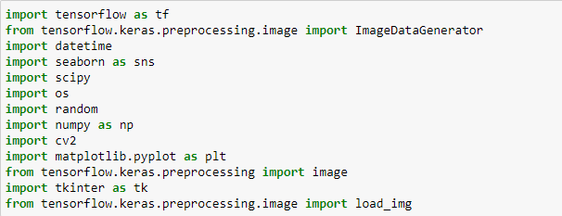
Imports
These are the imports we will be using for our models.

Slide 3
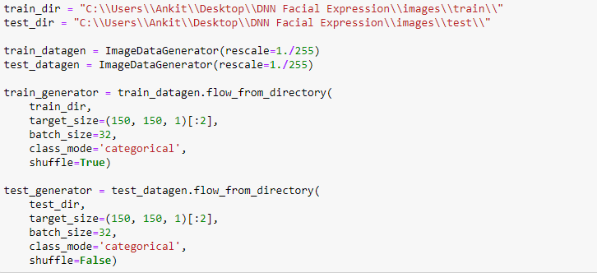
Pre-Processing
Text

Slide 4
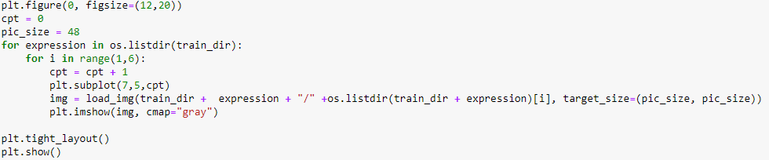
Display Images
Text

Slide 5
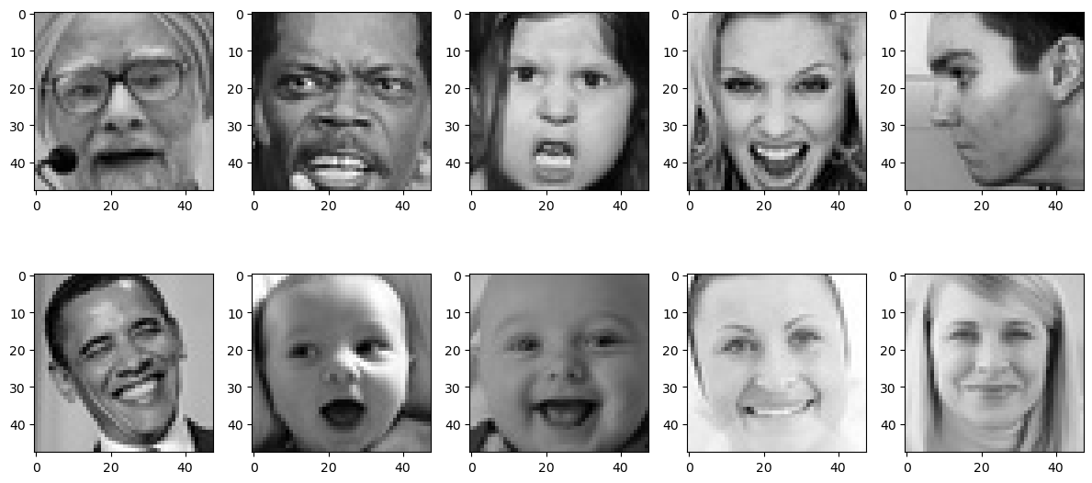
Images
Text

Slide 6
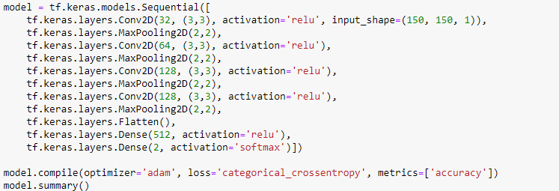
Model
text

Slide 7
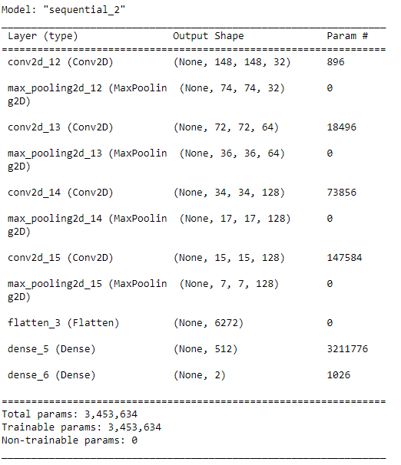
Model Summary
text

Slide 8
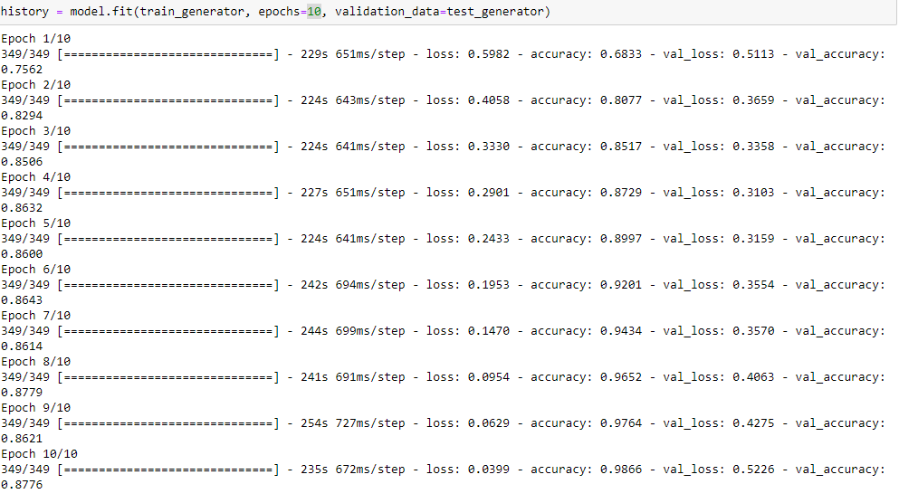
Fitting
Text

Slide 9
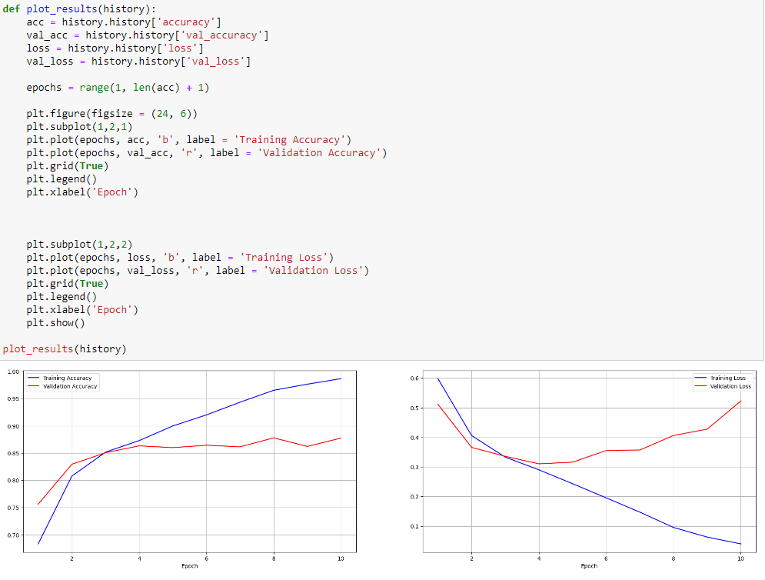
Plot Results
Text

Slide 10
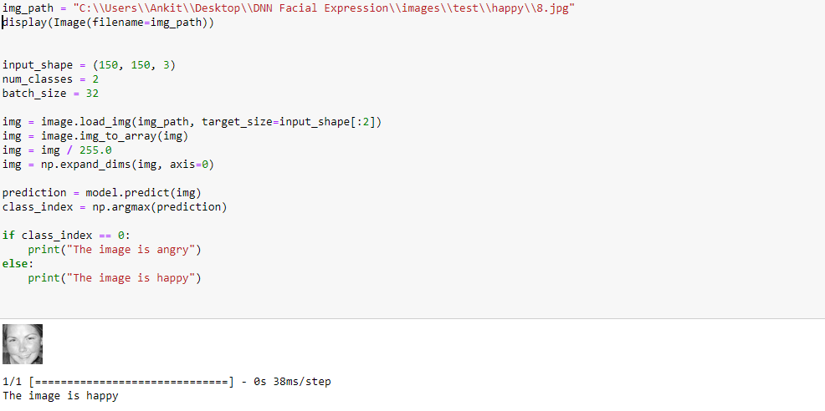
Prediction
Text

Slide 11
Title and Content Layout with List
Imports, training and testing, use to normalize the data, what gets our images from the directory, test generator doesn’t shuffle images
Empty canvas, 48x48 pixels, plot the images in grayscale
Model conf2d with relu to specify shape, maxpooling, repeat that, flatten layers, dense with soft max bc it was giving most accurate data
Basic summary, fit for 10 epochs, fit, plot results
Finally the prediction

